Slide 1
Dhaka University
Swimming Pool
Management System
Supervised by
Abdus Satter
Assistant Professor
IIT,DU
Submitted by
Eftekhar Mahmud Efty (1309)
Ibne Bin Rafid(1330)

Slide 2
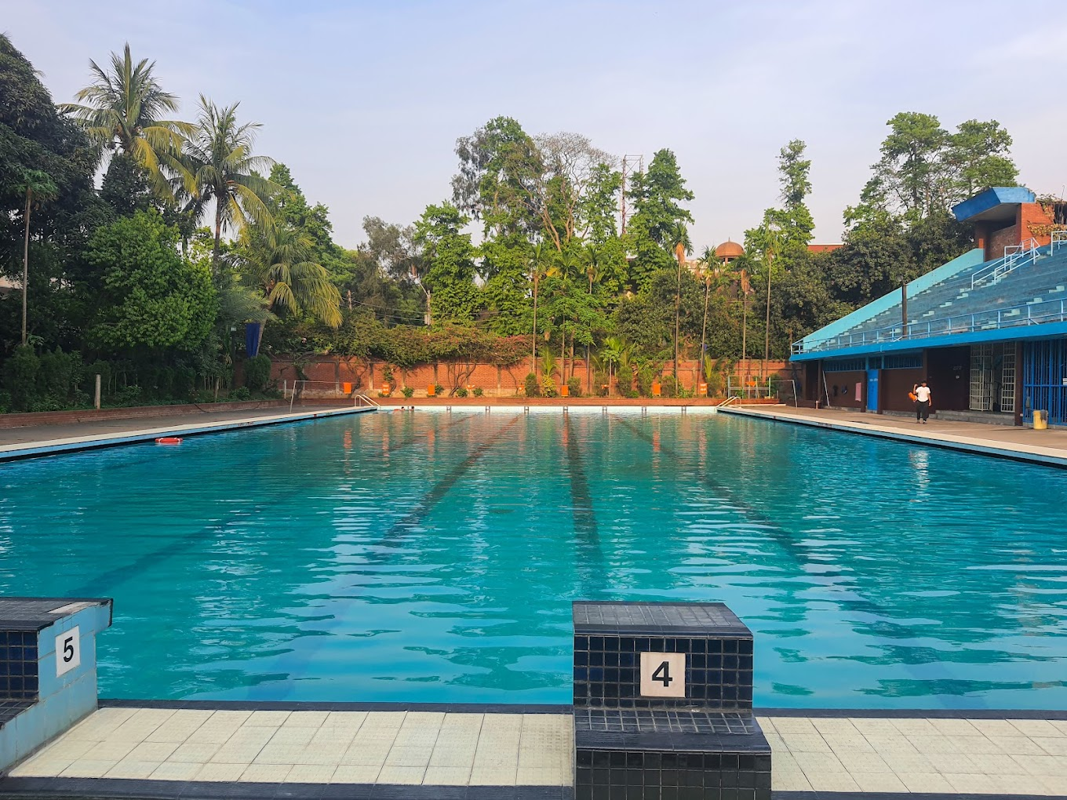
What is this Project?
The Dhaka University Swimming Pool Management System represents a digital solution aimed at streamlining the multifaceted tasks involved in efficiently administering Dhaka University’s swimming pool facility. Inspired by the commitment to elevate user experience and operational efficiency.

Slide 3
Stakeholders
Students
Teacher
Staff
Trainer
DU
Central Admin
Planning
Operator
Associate
Members

Slide 4
Quality Function Deployment (QFD)

Slide 5
Normal Requirements
Online form and Online admission
Online transaction through payment gateway
Per person login account
Notice to all
Submit and view reviews or feedback on their pool experiences
A comprehensive database will be implemented to securely store and manage information
Swimming Pool Profit/Loss

Slide 6
Expected Requirements
Schedule Management: Schedule management is a crucial aspect that will ensure smooth operations and optimal utilization of pool resources
Staff Management: A dedicated staff management module will be incorporated to oversee and manage information related to pool staff
Student Entry Database: The system will maintain a student entry database, capturing and storing relevant information about students

Slide 7
Exciting Requirements
Event Management: The system will feature an event management module, allowing for the seamless planning, organization, and execution of various exciting events within the swimming pool facility.
Lesson Management (video/guidelines): A comprehensive lesson management system will be implemented, incorporating video content and guidelines to enhance the learning experience for participants in swimming classes and programs
Course Management: This feature enables administrators to efficiently organize and manage swimming courses, classes, and training programs within the facility.

Slide 8
Use Case
Diagram

Slide 9
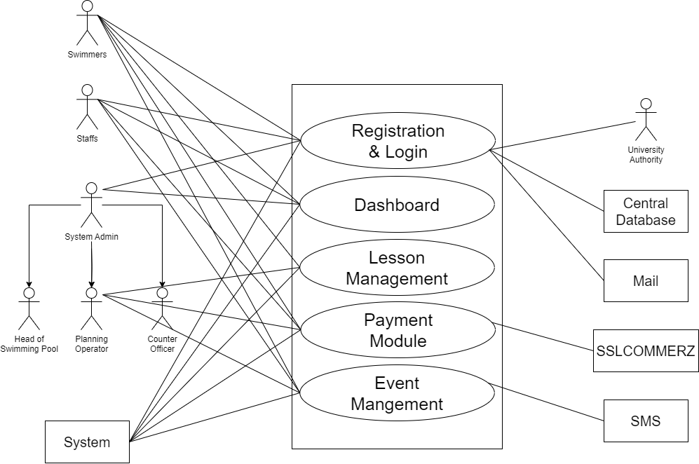
Use Case Diagram
Level 1

Slide 10
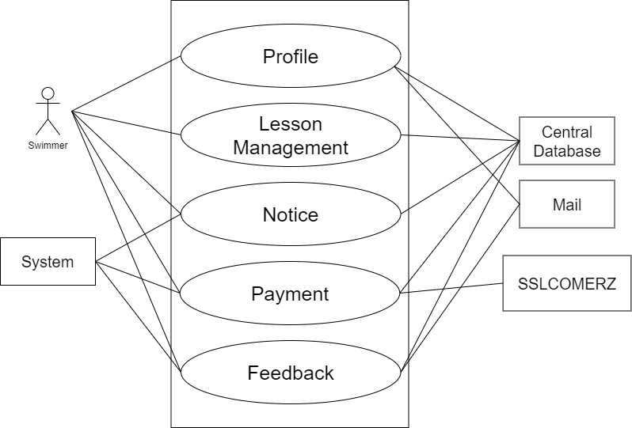
Use Case Diagram
Level 1.2.1

Slide 11
Activity
Diagram

Slide 12
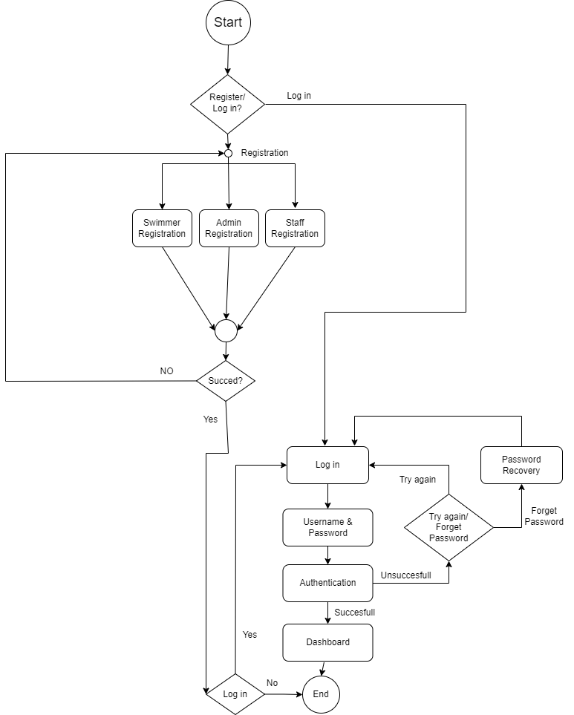
Activity Diagram
Level 1.1 (Registration and Login)

Slide 13
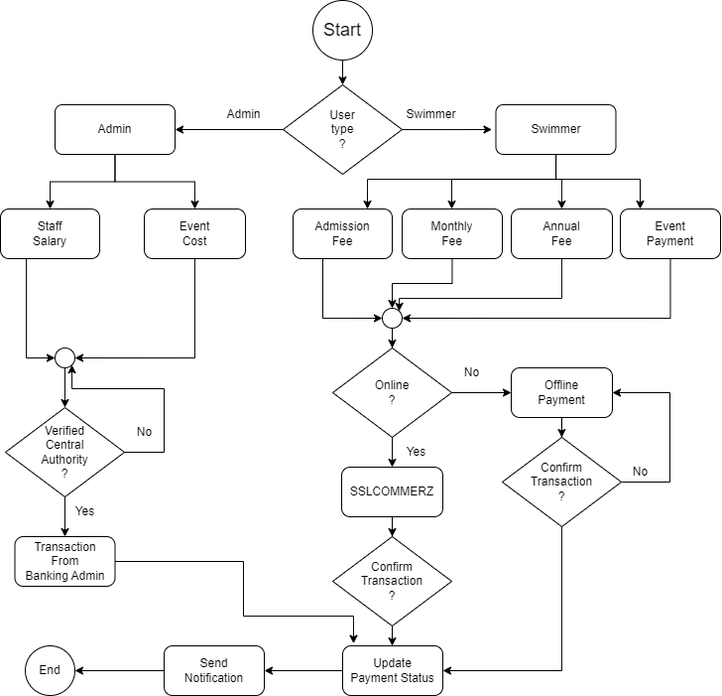
Activity Diagram
Level 1.4 (Payment)

Slide 14
Swimlane

Slide 15
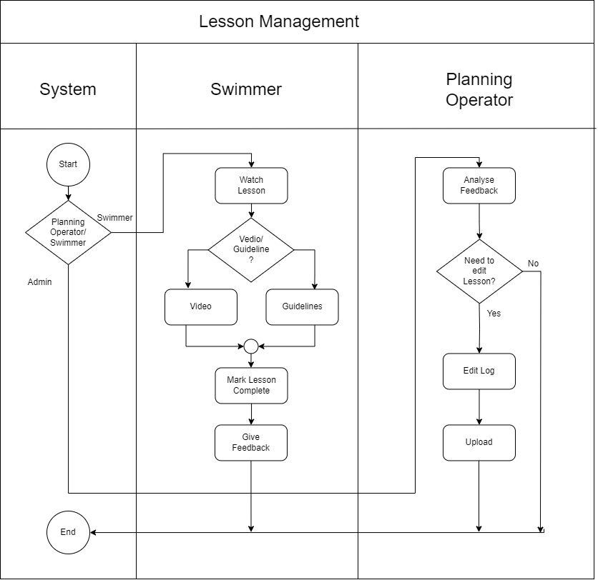
Swimlane Diagram
Level 1.3
(Lesson Management)

Slide 16
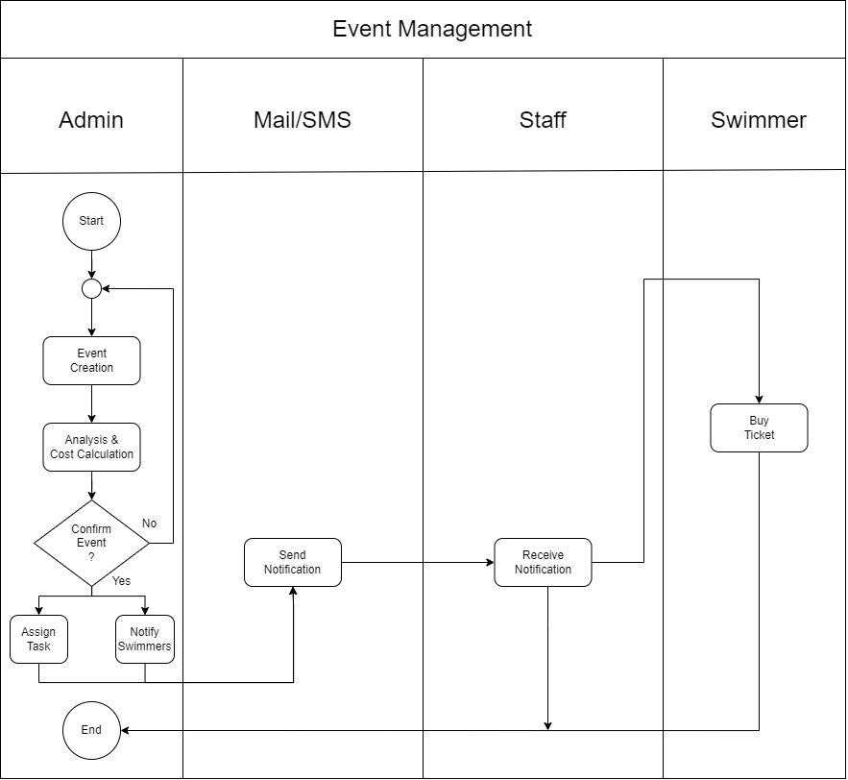
Swimlane Diagram
Level 1.5
(Event Management)

Slide 17
Data
Based
Modeling

Slide 18
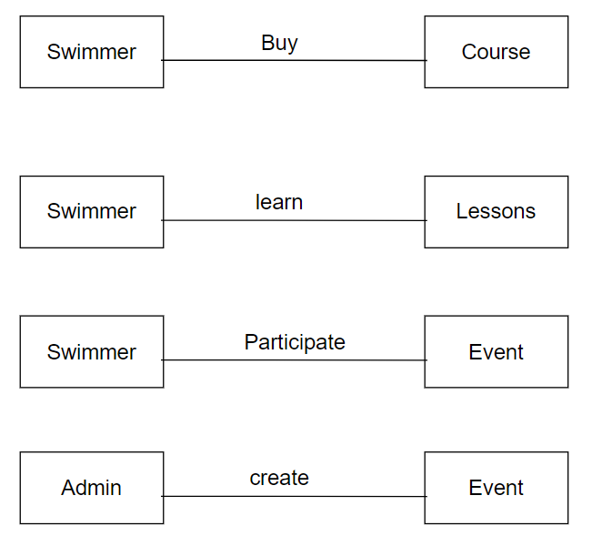
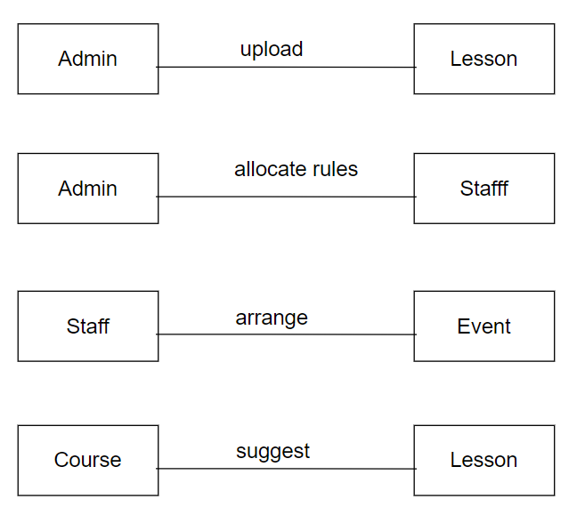
Database Relations

Slide 19
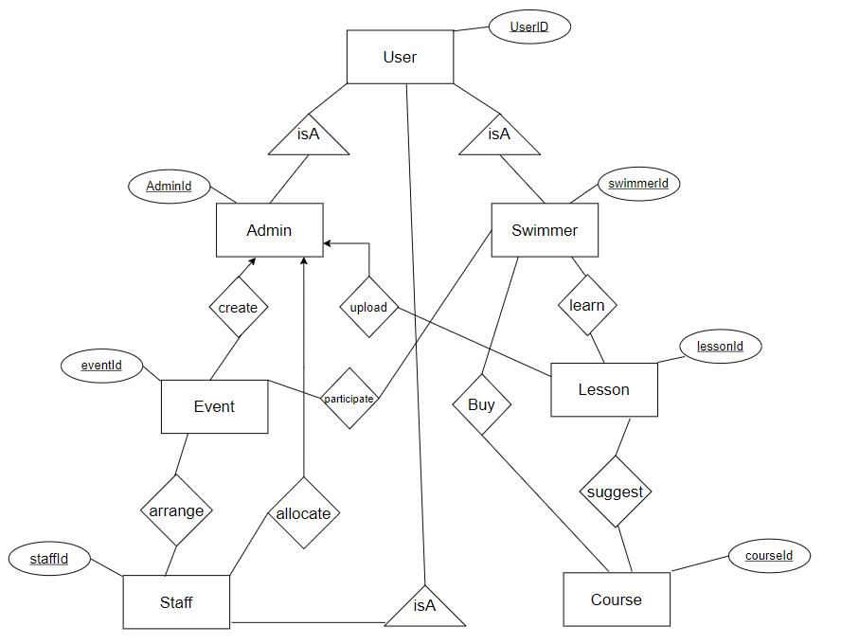
ER Diagram

Slide 20
CRC

Slide 21
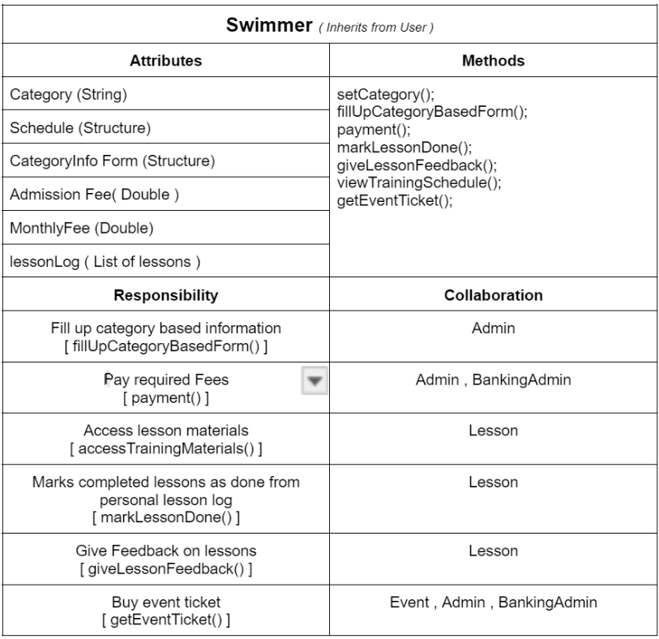
Class Card-Swimmers

Slide 22
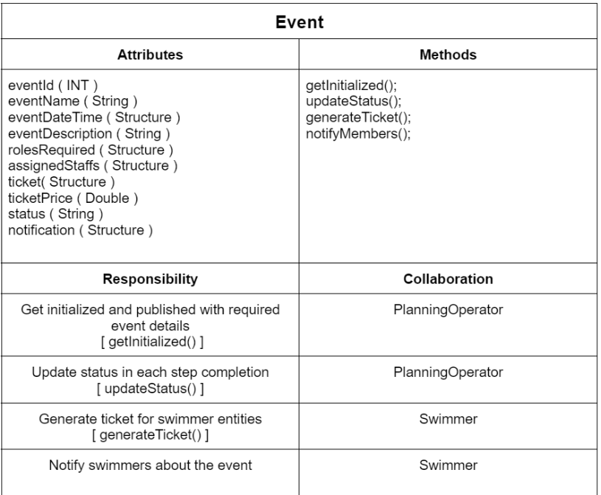
Class Card-Event

Slide 23
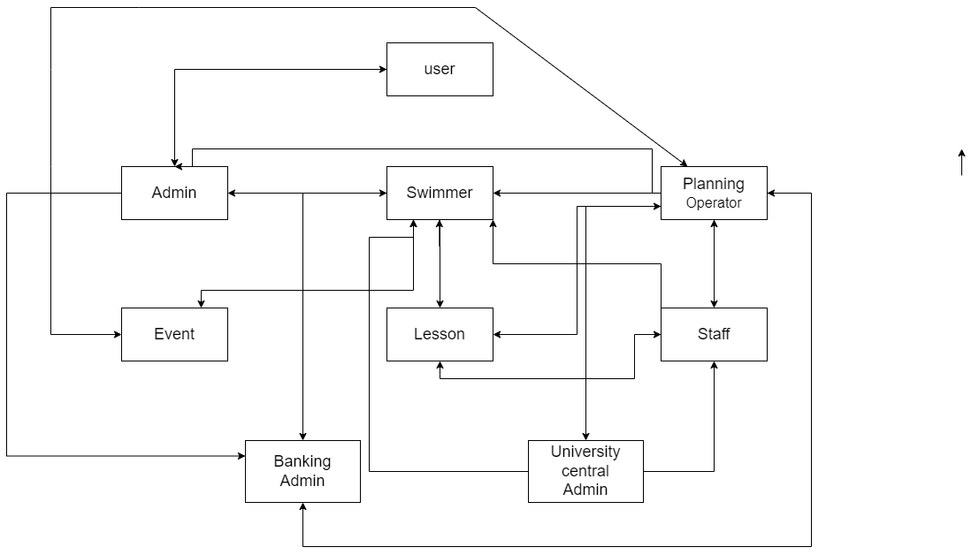
Class Responsibility Collaboration (CRC) Diagram

Slide 24
State Transition Diagram

Slide 25
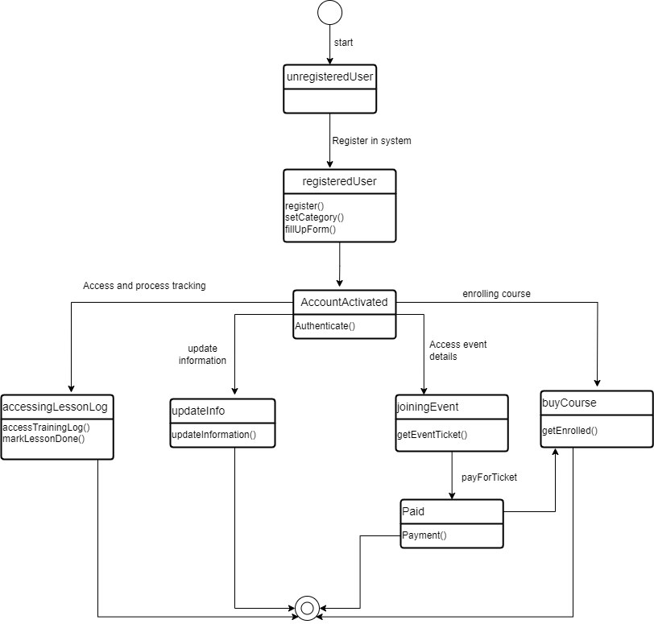
State Transition Diagram for Class: Swimmer

Slide 26
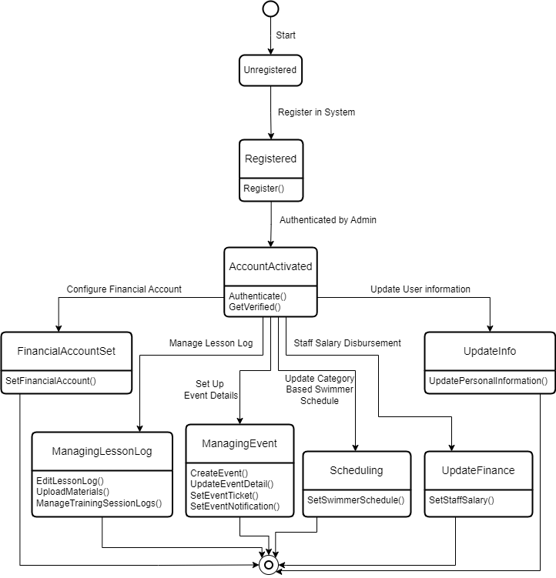
State Transition Diagram for Class: Planning Operator

Slide 27
Sequence Diagram

Slide 28
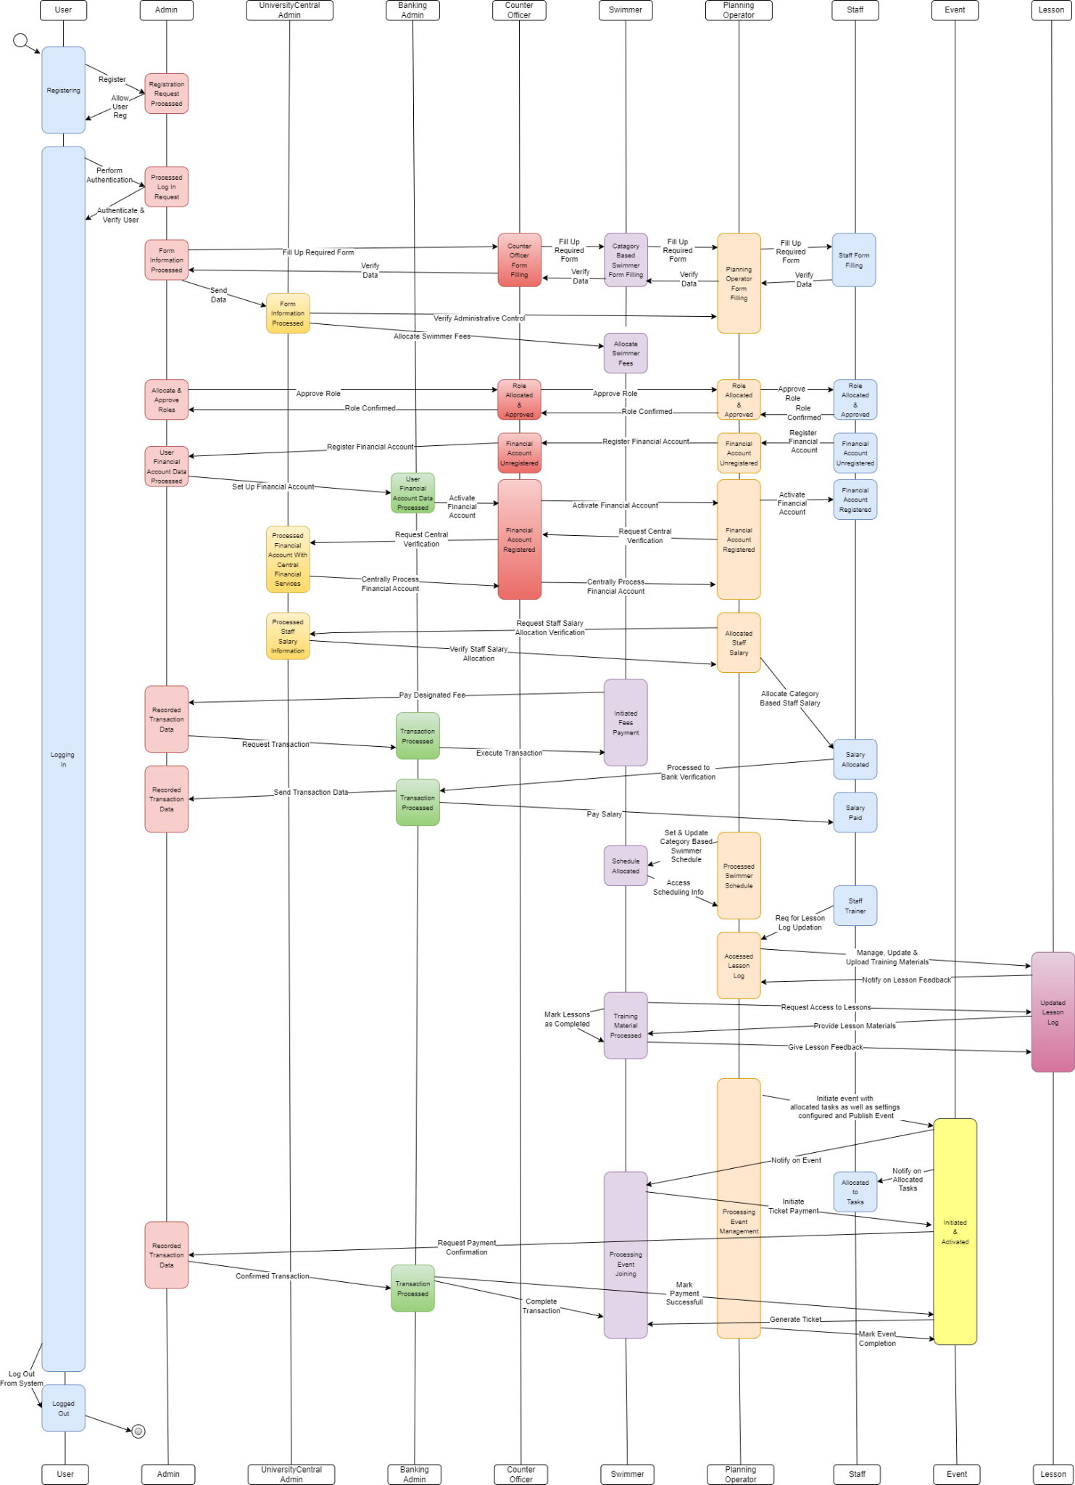
Sequence Diagram of
Assessment Management

Slide 29
Data Flow Diagram

Slide 30
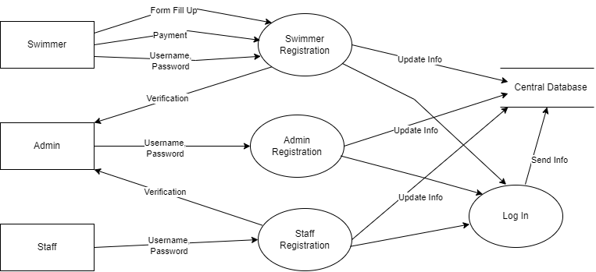
Data Flow Diagram (DFD) of
Registration and Login

Slide 31
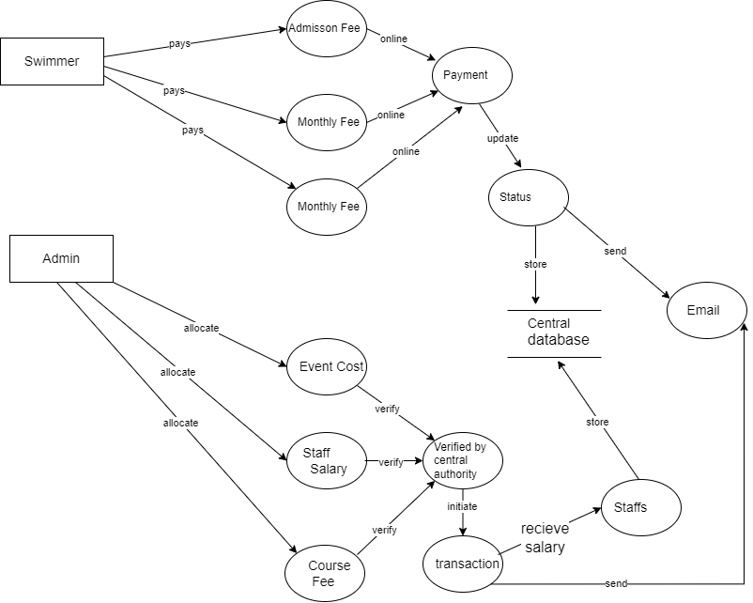
Data Flow Diagram (DFD) of
Payment

Slide 32
THANK
YOU!
SRS Document Link
Project Github link

